Slide 1


Economy: 6 pillars + theory + current + BES17 (pre cum Mains)
1.Banking, Fin, Insur.
6.HRD
2.Budget
3.BoP & Intl. Trade
4.Sectors
5.Infra
V1:c3,4
V1:c2,3, 6,9,11(GST),12,13
V1c:5
V1c:7,11(Agri)
V1c:10
v1c:12, 14; Budget^Rail

Slide 2
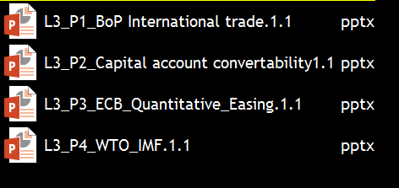

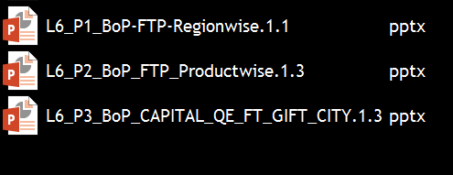
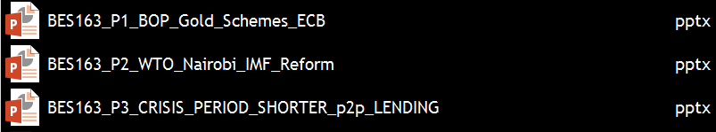
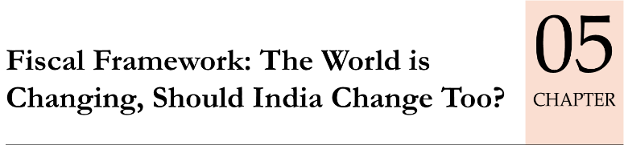

BoP, Intl. Trade: has been the most ‘fragmented series’ ☹
BES173: theory, current
BoP-Current
BoP-Capital
Intl. Orgs
Survey Ch.5

Slide 3

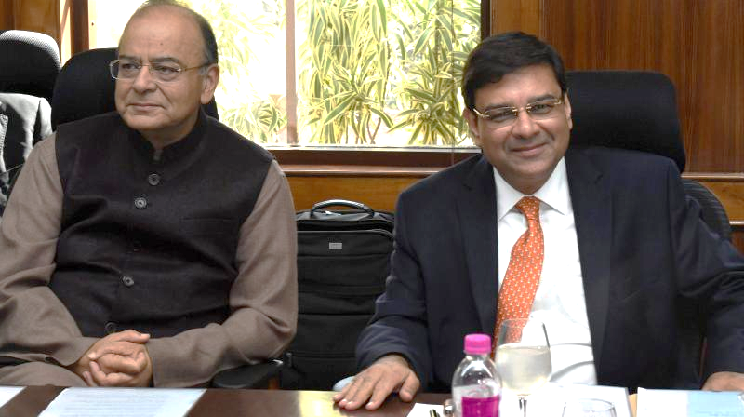
Compare and Contrast
Document
AFS (Budget)
BoP
Prepare
DEA
RBI
Format
Art.112: revenue xpdr. separate
IMF BPM-6
Figures
Indian Rupee
$
Data
Prev. & Next FY
Only Prev. Year

Slide 4

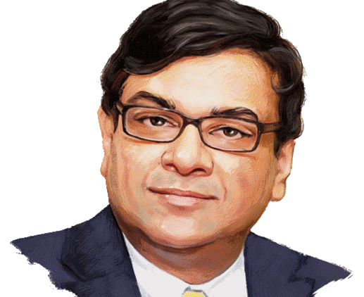
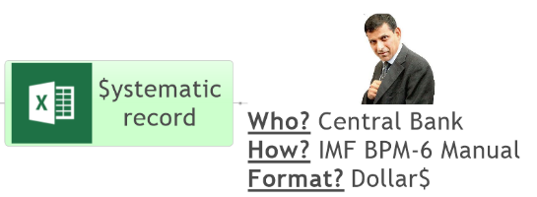



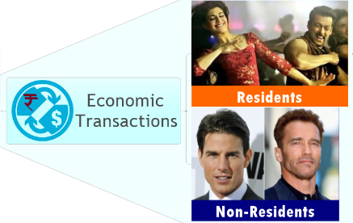


Define Balance of Payment (BoP)
World’s NET BoP = ZERO
DEBIT
CREDIT

Slide 5



IMPORT (-) Debit
EXPORT (+) Credit
IF BoT is
+ve = Trade Surplus (EX>I’M)
-ve=Trade Deficit (IM>EX)
Balance of Trade (BoT)

Slide 6
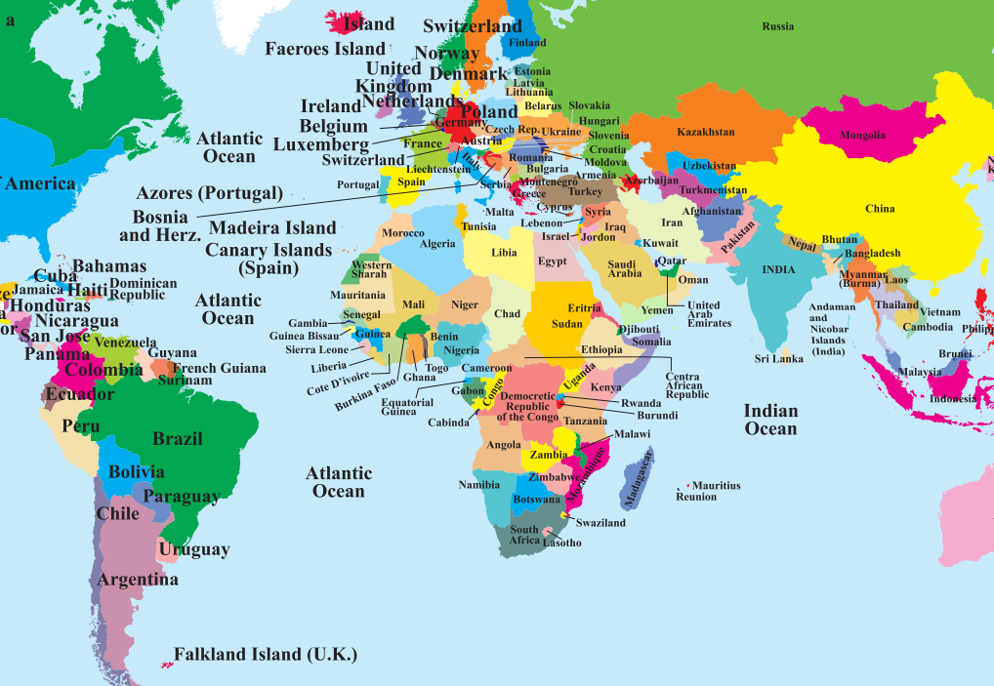
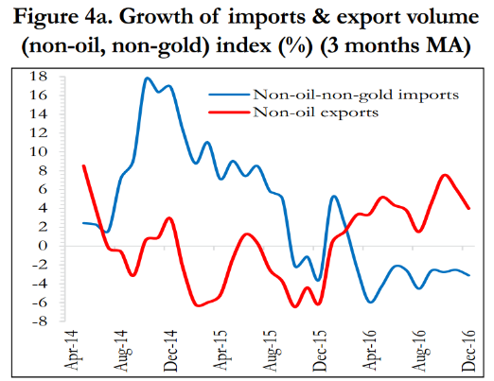




Top Imported Goods and Source Countries [2016]
Import Growth both has declined..
“Make in India success?”, “Demonetization”?
Crude
Gold & Gems
Electronics
Machinery
Chem & Fert.

Slide 7

Top Exported Goods and Destinations [2016]
Gems, Intermediate Goods
Value Added [China’s hinterland SEZ]
Re-Export
Tea, Rice, Automobile & Drugs
Gems
Textile
Petro
Chem
Agri

Slide 8
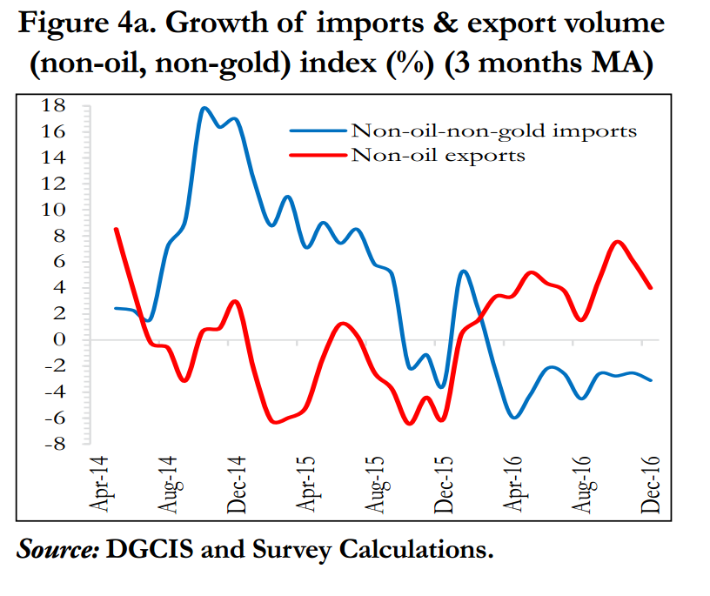
Export Growth both has declined..
“China slowdown”, “Protectionism”, Stringent rules (USFDA)…

Slide 9
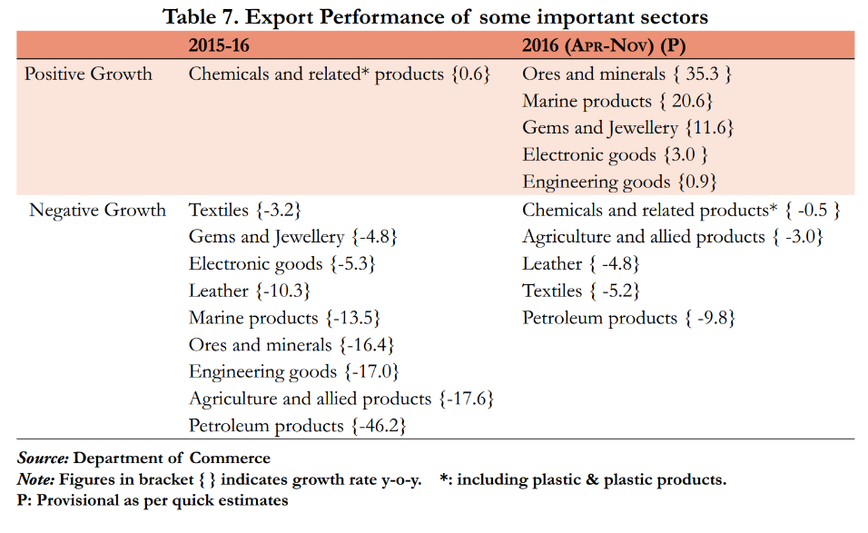


Export performance?
Make in India ☹

Slide 10
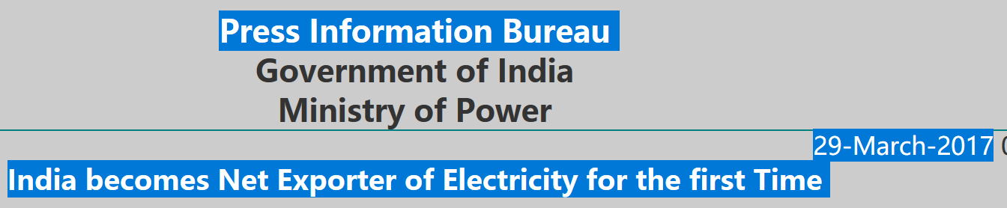
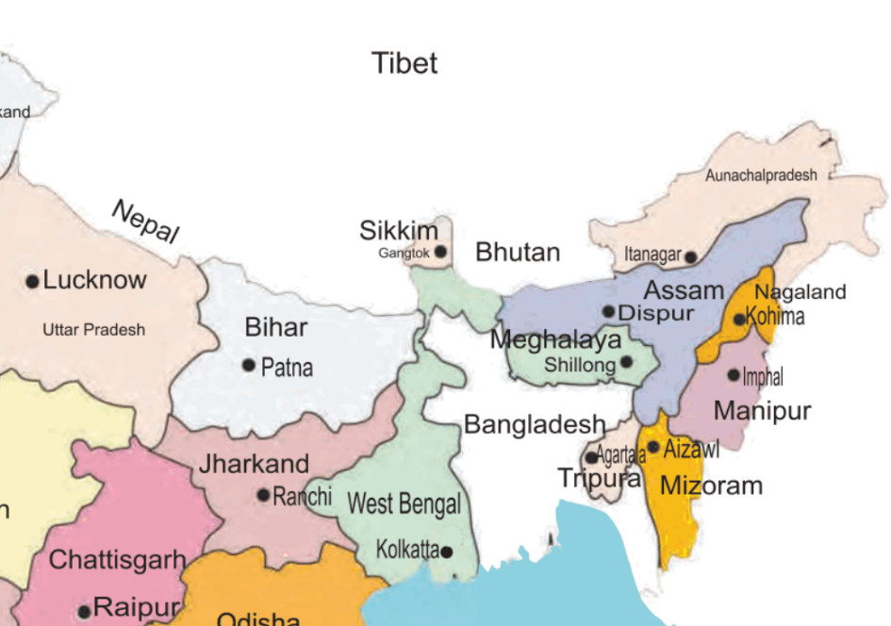



Cross border electricity trading permitted since mid-80s
Myanmar, Naypyidaw

Slide 11
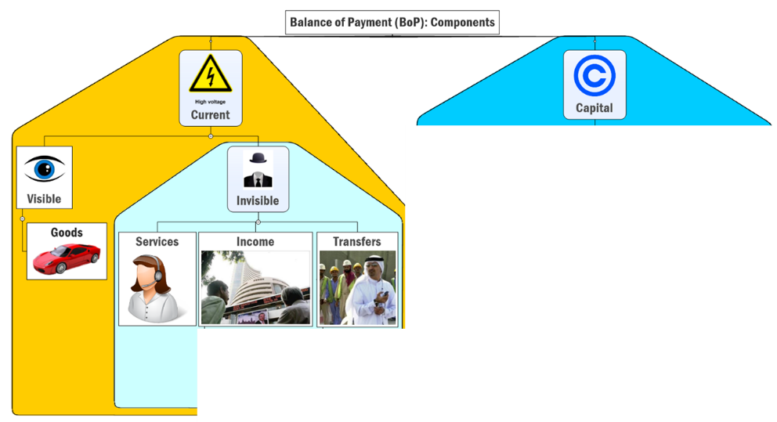

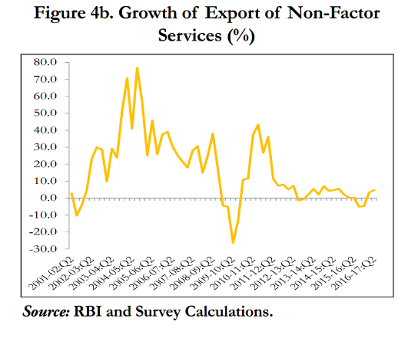


TRADE DEFICIT
ICT
Travel
Transport
Consultancy
Trade in Goods & services

Slide 12
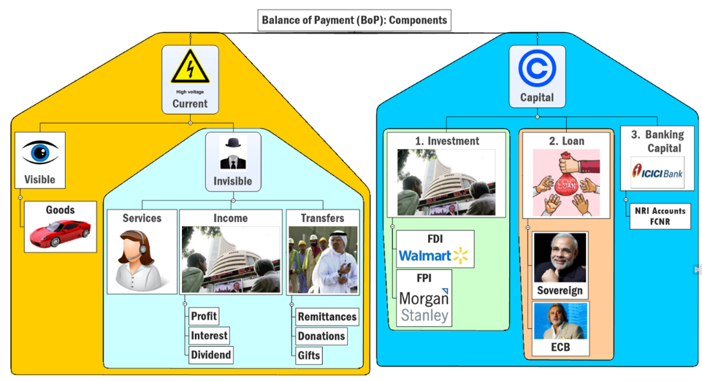


Slide 13
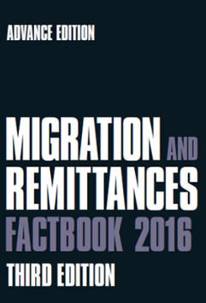
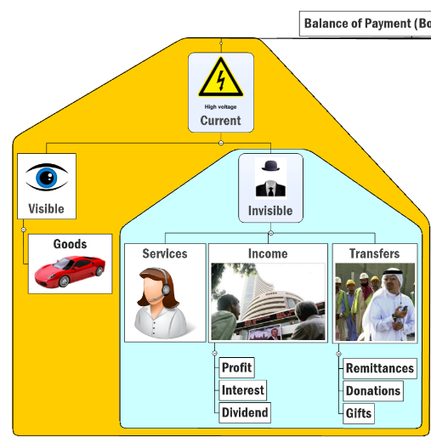

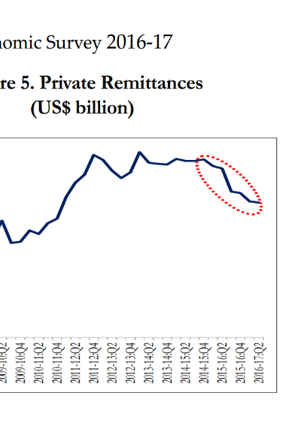
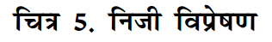


TRADE DEFICIT
Top Source
India (72 bn)
Top Destination
USA
Saudi
Russia
China
Philippines
Notes:
Crude oil price ▼=> Remittance ▼, not yet
But survey fears pink slips if this continues.

Slide 14
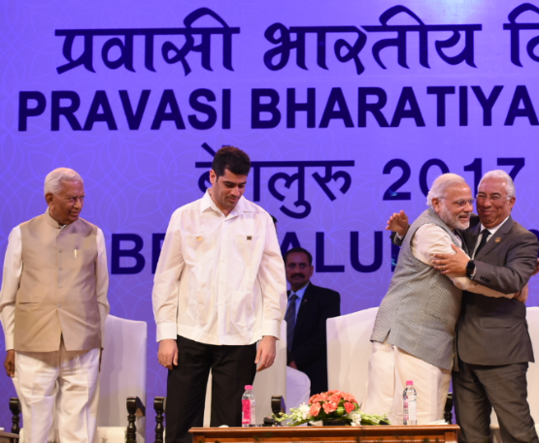
Pravasi Bharatiya Diwas: MORE in this article
MADAD App (MEA)
VAJRA Scheme (DST)
NRI in distress: work permit, visa. employer abuse
Visiting advanced joint research faculty scheme
NRI can work in India 3 months Per year, $ for travel
E-Migrate Portal (MEA)
Recruiting agents and foreign employers
1915, 9th Jan
2017:
Gandhi: S.Africa to Bombay
2003: Vajpayee started annually
2015: Modi: Biennial + Youth
14th @Bengaluru
THEME? Redefining Engagement with the Indian Diaspora
Guest? Portugal PM Dr. Coasta
WHO? MEA (MOIA merged)

Slide 15
Mock
Find Correct Pair
POCSO e-complaint: Home Ministry
Madad App: Minority Affairs Ministry
BHIM App: Finance Ministry
Answer choices
Only 1 and 2
Only 2 and 3
Only 1 and 3
None of them

Slide 16
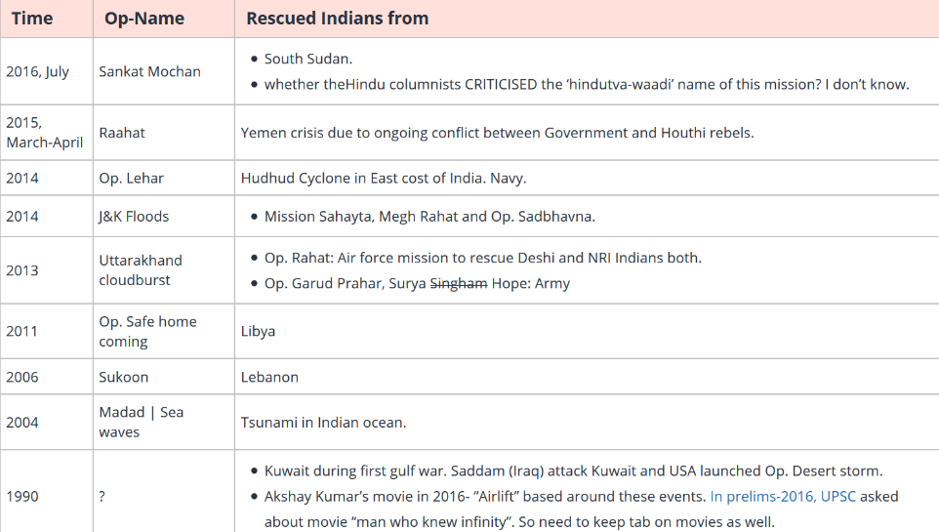

Rescue Ops for Indians
+ Laxmikanth Citizenship chapter on OCI, PIO.., voting rights, FR:“alien”?

Slide 17
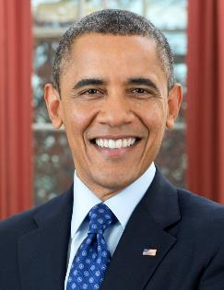
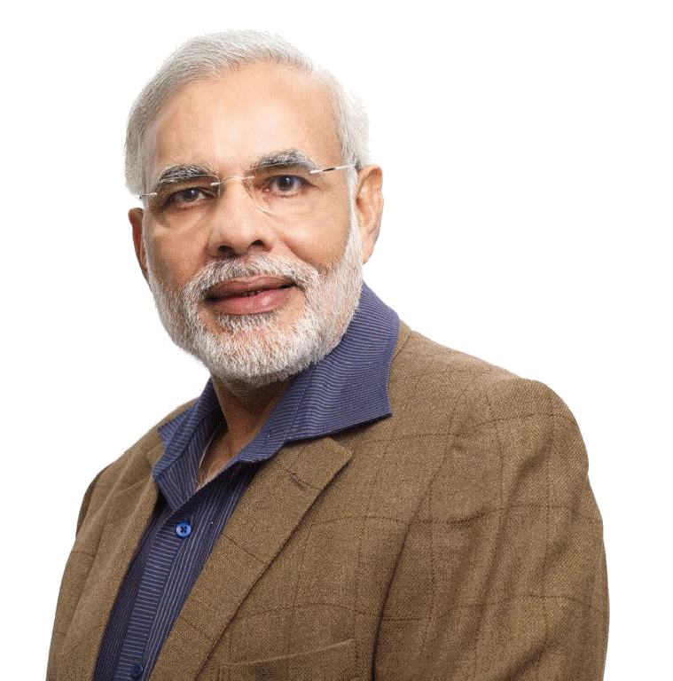
Since UPSC asks 1.5-2 years old “current affairs”..
FATCA Act: share info about US citizens investing in Indian Bank-FI
Totalization Pact (?): NRI-> USA’s “EPFO” (Social security 15% compulsory)..but when return to India..They should get that amount…
NISAR: ISRO-NASA Joint radar
Notes:
5 lakh NRIs contribute ~1 billion$ in taxes, to USA’s social security system. (~15% of salary)
Many of them don’t have full immigrant visa and have to leave USA after 3-7 years.
But as per US social security norms, if a person doesn’t work for 10 years continuously in USA, his social security contributions are forfeited.
Since 2007, India trying to solve this issue by signing a totalization pact with USA. We already have such agreements with 17 countries including Australia.
But Americans don’t agree, saying Indian social security system (administered by EPFO) is not compatible with their hi-fi system.

Slide 18

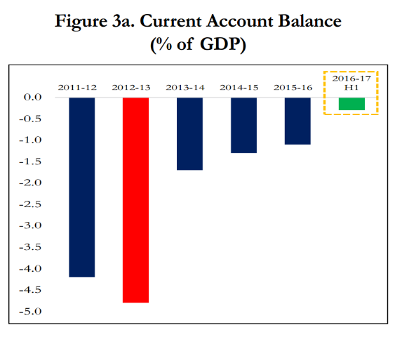
Calculating current account deficit (CAD)
2016-17 1st half:
ABS: -3.7 billion$
GDP: -0.3%
Current Account DEFICIT
चालू खाता घाटा
TRADE DEFICIT
Although ▼ than last year’s H1
mainly on account of crude oil prices
--
Same for trade deficit

Slide 19

How to control Current Account Deficit ?
Oil
“Strategic Reserves”
Gold
“Schemes”
Export
Policy & Scheme
CAD is bad because
It weakens your currency: crude oil import becomes more expensive: petrol diesel transport expensive: inflation
Can lead to BoP crisis: How: we’ll study in second part
Reduce Import

Slide 20

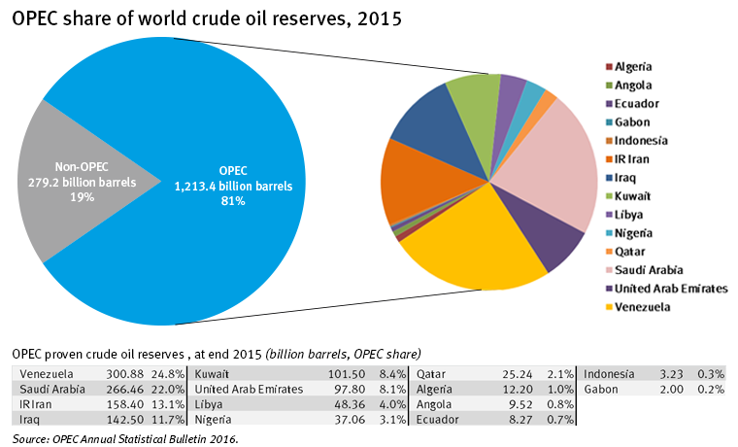
Setup: 1960 under Bagdad Agreement
HQ: Vienna, Austria
Russia

Slide 21
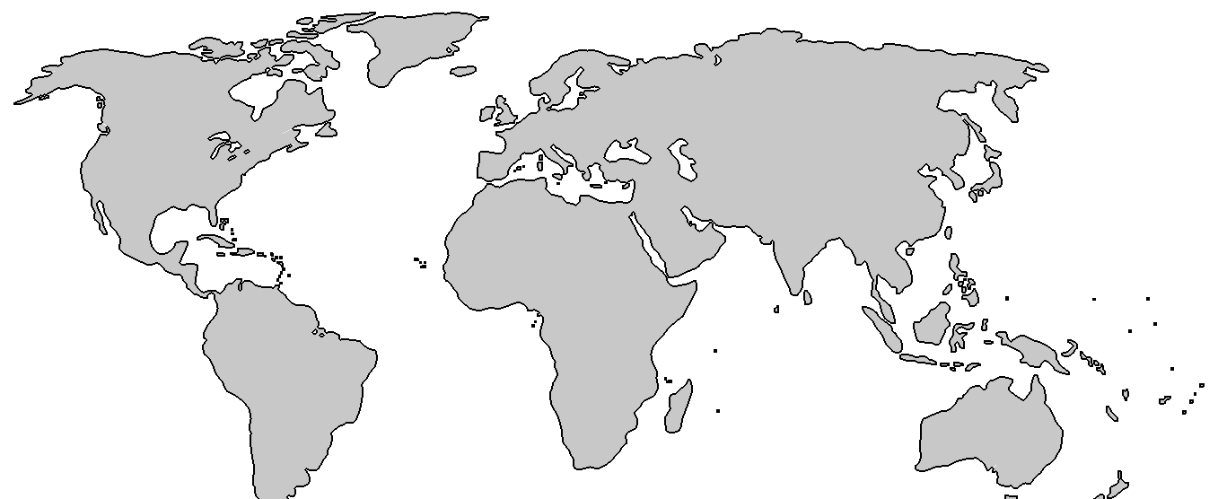
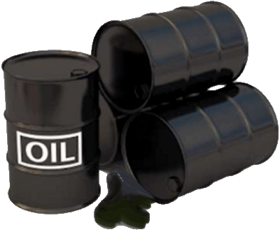
Why oil price Fell 2013-16
EU, China
growth▼
US: Shale Gas, Oil ▲
OPEC Cartel ▼
Saudi did not cut production so to hurt Iran
India EXCISE on Diesel
2014: ~6 / lt.
2016: ~20/ lt
This is implicit ‘carbon tax’, says survey, why: BES17”5” <INFRA>
Oil price movement= Brent Index
Notes:
from >100 per barrel to <50$
China, EU Growth▼=oil demand ▼
US oil + shale gas production ▲
OPEC oligopoly ▼, S.Arabia did not ▼ production
Survey predicts: $60-65 / barrel, so, inflation and CAD will be moderate for 2015-16

Slide 22
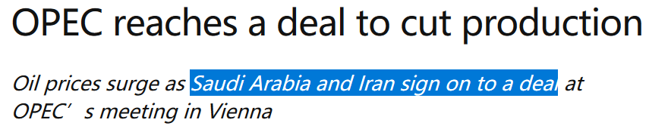
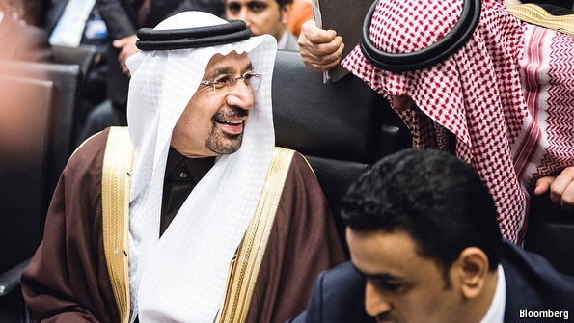
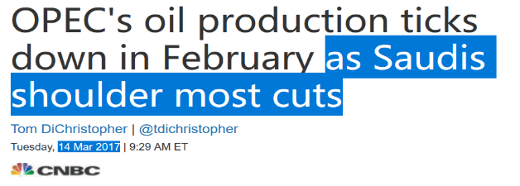
Even [Non-OPEC] Russia roped in! Dec’16

Slide 23
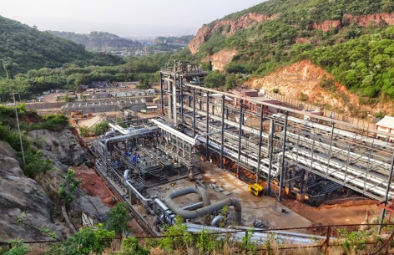
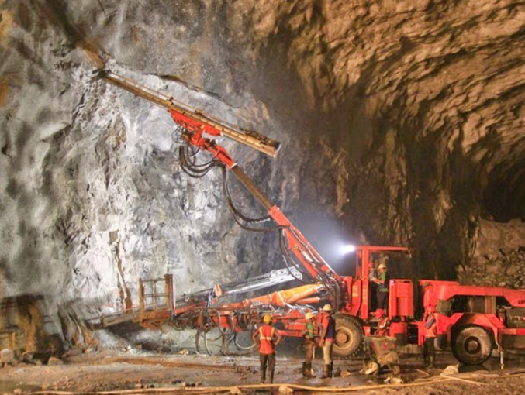
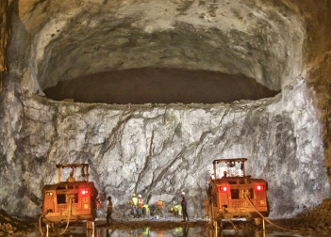
Indian Strategic Petroleum Reserve (ISPRL) ltd. (under Petro Min)
Supply via pipeline, ships, tankers.
Just like Counter cyclic Capital “BUFFER”…
Store in underground rock caverns
Strategic (war) + commercial purpose
Notes:
To ensure energy security, the Government of India had decided to set up 5 million metric tons (MMT) of strategic crude oil storages at three locations namely, Visakhapatnam, Mangalore and Padur (near Udupi). These strategic storages would be in addition to the existing storages of crude oil and petroleum products with the oil companies and would serve as a cushion during any external supply disruptions. The construction of the Strategic Crude Oil Storage facilities is being managed by Indian Strategic Petroleum Reserves Limited (ISPRL), a Special Purpose Vehicle, which is a wholly owned subsidiary of Oil Industry Development Board (OIDB) under the Ministry of Petroleum & Natural Gas. Engineers India Limited (EIL) is taken as the Project Management Consultant for all three projects.
Underground rock caverns are considered the safest means of storing hydrocarbons.

Slide 24
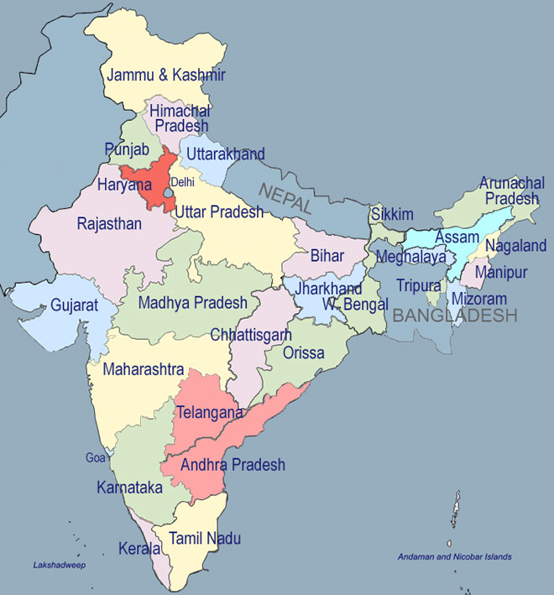
Location: strategic oil reserve…. [procure from Abu Dhabi, UAE et al]
Bikaner , Raj
(Budget 2017)
Chandikhole, Odisha
(Budget 2017)
Vishakhapatnam, AP
Mangalore, KarN
Both East Coast
and West Coast
Padur, Kerala

Slide 25
Mock Question
Correct statements about location of Strategic Oil reserves in India
They’re only located at the Western Coast of India
They’re only located in the coastal states of India
Defense Ministry is responsible for maintenance of these reserve.
Answer Choices
a) Only 1 and 2 (b) Only 2 and 3
c) Only 1 and 3 (d) None of them

Slide 26
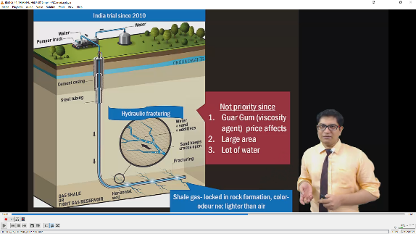
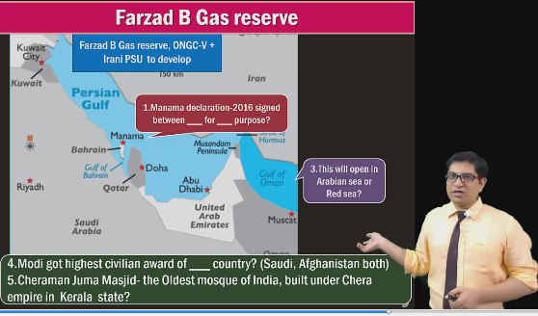
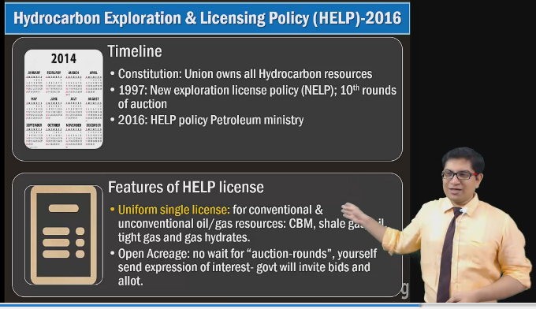
What else to improve our energy security?
SELF STUDY
BES16”5”
Environment playlist

Slide 27
How to control Current Account Deficit ?
Oil
“Strategic Reserves” etc.
Gold
“Schemes”
Export
Foreign Trade Policy

Slide 28

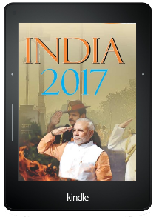

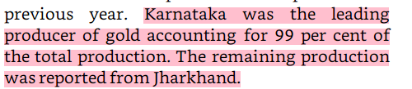
Gold: DESHI and Videshi
Switzerland
UAE
S.Africa

Slide 29
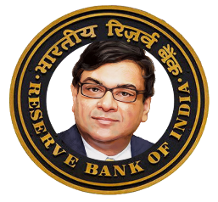
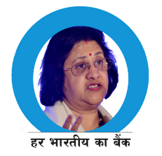

So why is gold obsession bad for economy?
Inflation
Gold [+ve interest Rate]
CAD ▼
Rs. Weak ▼
Petroleum Expensive ▲
Bank Deposit Growth ▼
Non transmission of Monetary Policy

Slide 30
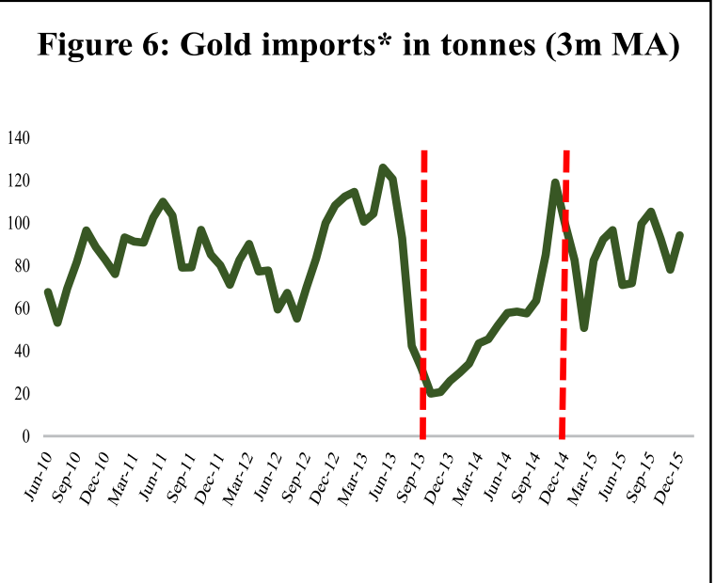
Custom Duty hike
80:20 Rule: 20% gold must be ‘re-exported’ [RBI ended ‘14]
Inflation indexed bonds (IIB)
Gold Bond
Gold Monetization
Budget 2015
Notes:
2013: 80:20 rule. 20% of gold must be re-exported (e.g. by jewelry making)
Inflation indexed bonds (positive real interest rate).
End result: 750 tonnes (2013)=>650 tonnes (2014)
Nov 2014: 80:20 restriction lifted by RBI

Slide 31

Principles
“Bond”
Expressed in “gms”. But you physical gold: DEMAT bond
Interest
Maturity: Market price of gold of that many gms.
Can sell to another party also.
“Monetization”
Deposit your gold / jewelry in “Account”
Interest
Maturity: gold / equivalent Rs. (market price)

Slide 32


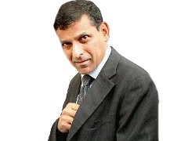
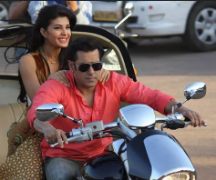
Sovereign Gold Bonds; CGT exempted IF kept till maturity
Issued on Government’s behalf
Sold @banks, post offices
“auction” system
Paper format
KYC yes
RESIDENT
CITIZEN
Minor, Jt.Holdiing, HUF, Charities, Universities
DEMAT format
2 to 500 gms;
Per person per year
2.75% CI half yearly | Tenor: 8 years
Redeem: Rs. price of gold @Maturity
Can be used as loan collateral
To settle losses of Veer 2, Jai Ho 2
Tenor 8 year; Can Exit from 5th Year
Tradable on exchanges = can exit faster
‘gold reserve fund’ to cover the risk of gold price movement.
Notes:
Gold ETF: mutual fund, no interest.
With every issue Government can change…interest rate.
Eligible investors include individuals, HUFs, trusts, universities, charitable institutions, etc.
RBI issues them on govt's behalf
Denomination: in grams
Only for Resident Indians (KYC=Gold)
Available in both in demat and paper form.
Min. 2 gm; Max. 500 gms per person per year
Interest: 2.75% compounded half yearly
Tenor: 8 years, can exit from 5th year
Redemption: Rs. Price @time of maturity
Capital gains tax: exempted
Two rounds so far- ~4000kg worth gold bonds sold @~1kcr.

Slide 33


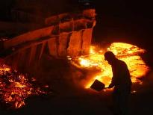

Gold Monetization Scheme: CGT exempt yes
RESIDENT
CITIZEN
Min. Deposit 30gm
Max. NA
BIS certified Collection, Purity Testing Centres (CPTC)
REFINERS
Tri-partite agreement
Term | Year | Interest | Redeem
Short | 1-3 | 2.25% | Cash / gold
Medium | 5-7 | 2.5% | Cash
Long | 12-15 | 2.5 | Cash
Gold Savings Account
Denomination in GRAMS
Why Gold schemes not getting much response
Interest too low, Lock in period too high.
Counter: can be used Loan collateral
KVP, PoRD, NSC etc offer better return
Counter: Gold price @Maturity
But, There may be a risk of capital Loss if the market price of gold declines. (gms remain same but can’t redeem in “gold”)
Notes:
Bureau of Indian standards (BIS) came into existence, through an act of parliament dated 26 November 1986, on 1 April 1987, with a broadened scope and more powers taking over the staff, assets, liabilities and functions of erstwhile ISI. Through this change over, the government envisaged building a climate for quality culture and consciousness and greater participation of consumers in formulation and implementation of national standards.
The Bureau is a Body Corporate consisting of 25 members representing both Central and State governments, Members of Parliament, industry, scientific and research institutions, consumer organizations and professional bodies; with Union Minister of Consumer Affairs, Food and Public Distribution as its President and with Minister of State for Consumer Affairs, Food and Public Distribution as its Vice-President.
Customers deposit gold to CPTC
certified by Bureau of Indian Standards
Min. 30gm, max- NA [So far >1k kg. gold mobilized]
Gold savings account in Bank.
denomination in grams of gold
short-term: 1-3 years (2.25% interest)- RDM Cash/Gold
medium-term: 5-7 years (2.5% interest)- RDM Cash
long-term: 12-15 years (2.5% interest)- RDM Cash
CPTCs transfer the gold to the refiners.
The banks will have a tripartite / Bipartite Legal Agreement with refiners and CPTCs.
Tax exemption are same as those available under GDS 1999.

Slide 34
How to control Current Account Deficit ?
Oil
“Strategic Reserves”
Gold
“Schemes”
Export
Policy & Schemes
Reduce Import

Slide 35

BASICS
FTP-2015
Under Foreign trade Development and regulation act 1992
Who? Director General of Foreign Trade (DGFT) under Commerce Min.
When? 2015-20. upto 31/03/2020
Year | Export (US billions.) | World Share in Export
2013 | 465 | 2%
2020 31st March | 900 | 3.5%

Slide 36

FTP-2015: Region wise Strategies for Mains (GSM2 and 3): link
US,EU
China, Japan
SAARC
ASEAN
WANA
LAC
Russia, CIS
Africa
Env/ICT challenges
Explore non-EU
SAFTA service, Grid, Value added chain
FTAs: pro, anti
transport
Market access difficult
Language barrier
Russia = problem
CIS = market + RAW + EU entry
Contract Farming
Project Loans
FTAs with Israel, GCC, SAU, COMESA, ECOWAS

Slide 37


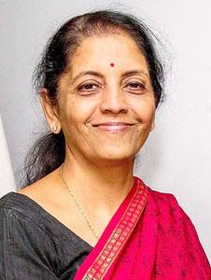

Service export from India scheme (SEIS): 2015-17
Payment of Customs Duties to import of inputs
Payment of Excise Duties on domestic procurement of inputs or goods.
Payment of Service Tax on procurement of services
Payment other fees.
Similarly, Merchandise Exports from India Scheme (MEIS).
$100
Can use paying Taxes
$5 Scrip
Separately
“Status holder” if exporting “X”
Faster clearance, self-certification etc.
DGFT, Comm Ministry

Slide 38
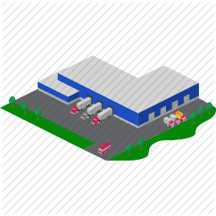
Tax & infra Special economic zones
FTP-2015
1965: Export processing zone @Kandla, Gujarat
2005: SEZ Act
SEZ Bottom-line: Export promotion through tax incentive.
Export Units
EXPORT ORIENTED UNITS (EOUs),
ELECTRONICS HARDWARE TECHNOLOGY PARKS (EHTPs),
SOFTWARE TECHNOLOGY PARKS (STPs)
BIO-TECHNOLOGY PARKS (BTPs)
Defense Technology park [Ottappalam, Kerala]

Slide 39
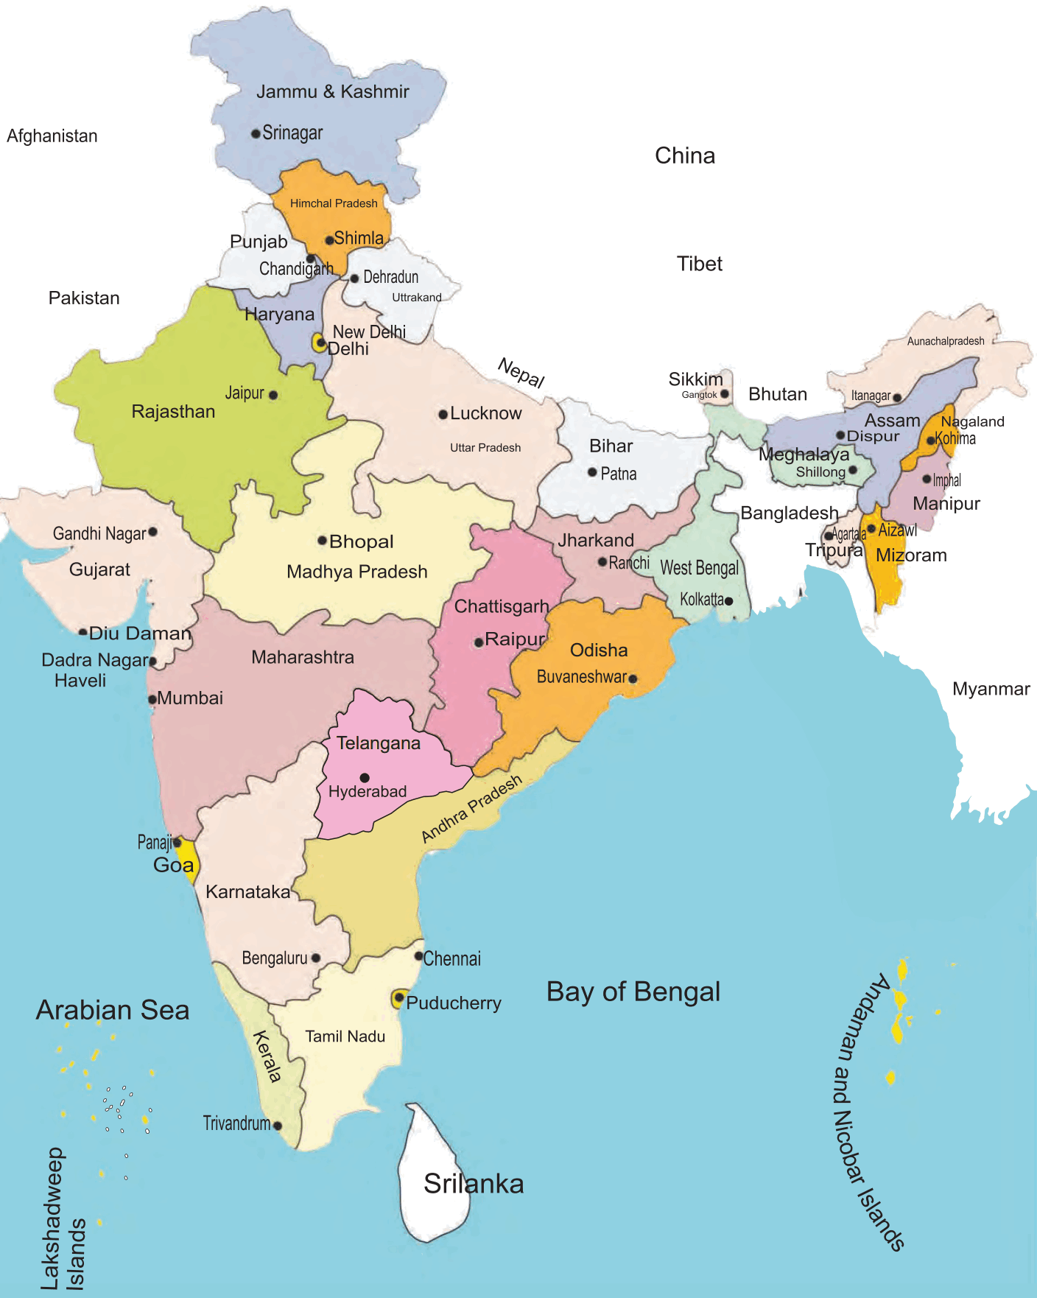
Towns of Export Excellence (TEE): union gives $$ for infra Development
Location FACTORS?
Woolen, Knitware
HAR, Punjab
Handicraft, Leather, Glassware (Firozabad)
Handicraft
A’bad-Textile,
Surat-Gems,
Morbi- Ceramic
Indore (soya), Dewas (Pharma)
Bamboo
Agartala
seafood
Assistance to States for Developing Export Infrastructure and Allied Activities (ASIDE)
By Department of Commerce
Help States to fill infrastructure gaps with this money
Textile
seafood
Coir, Cashew
handloom, Marine
List is not exhaustive
Notes:
Assistance to States for Developing Export Infrastructure and Allied Activities
By Department of Commerce
Help States to fill infrastructure gaps with this money
ASIDE allocation ▼ in Budget 2015
Reason: 14th FC’s 42% devolution (L4/P3.pptx)
FTP-2015: restructure ASIDE, Strengthen SEZ

Slide 40
Export infrastructure
2015: ASIDE was stopped. (14th FC grant)
2017: Budget- Trade Infrastructure for Export Scheme (TIES)
Commerce Ministry.: Union to give max. 20 cr. Grant in each infrastructure project.
Budget 2017

Slide 41
How to control Current Account Deficit ?-> Export ▲
Agri, Handicraft, Misc.
TEE
Pharma
Biotech Parks
Physical Goods
SEZ, Electronic Parks
IT Services
Software Technology Park
Financial services
?? GIFT CITY?
Oil
“Strategic Reserves”
Gold
“Schemes”
Export
Foreign Trade Policy

Slide 42


International Financial Centre (IFC)
Tax
0% tax for 50 years
DTAA with most
Investment:
CaC: 100% (Invest & pullout money as & when you please!)
FDI: 100%
Independent judiciary not bound with local laws
Quick Visa etc.
UAE’s LARGEST city
DUBAI
Notes:
Independent judicial system, complying with 1st world laws.
high speed net, transport.
Skilled professionals, quick visa processing and work permits in single window.
Art galleries, restaurant, fashion, vibrant social /club life, apartments, hotels

Slide 43

??
some
incoming
GIFT city: Smart city model
Trickle down in Gandhinagar- A’bad. Taxi, Metro etc.

Slide 44

Gujarat Intl. Financial Tech City: JV between
GIFT ltd. (SPV)
ILFS: Infrastructure Leasing & Financial Services Limited
Central India Bank
Guj.Urban Dvlp co. ltd
UTI, LIC
SBI, HDFC
2015
Budget: will promote this GIFT city, as IFSC international financial services centre)
2017
Yes Bank’s branch crossed $1 bn biz. (CRR, SLR, applicable)
Financial SEZ: separate rules by RBI, SEBI, IRDA
Belgium: first to open Consulate
Between Gandhinagar, A’bad
“greenfield City”
Diamond Tower
Now proposal for an IFSC in Mumbai also
Notes:
“Greenfield” business city in Gandhinagar district
Smart city = automated waste collection system, centralised cooling, civic amnesties using ICT
Main attraction – diamond tower of 88 storey
Budget-2015: will promote GIFT city as intl.financial service centre (IFSC)
All investors /operators are “non-resident Indians outside India” for tax purpose
Invest in Hedge fund (Alternate investment fund) and mutual funds BUT in foreign currency only (L2/P1)
Merchant bank, Depository receipts, stock exchange…yes but norms on min.capital etc.
NSE will setup international exchange for trading of shares, bonds, currencies and derivatives

Slide 45



